Slide 1
Basic Concepts of Chemical Bonding
Chapter 8

Slide 2
Chemical Bonds, Lewis Symbols and the Octet Rule-- Section 8.1
A chemical bond is formed by sharing or donating electrons between multiple atoms
Three main types of chemical bonds:
Ionic (No sharing of electrons)
Covalent (Electrons are shared albeit to different extents)
Metallic (Occurs only in purely metallic samples, e.g. iron, copper, gold)

Slide 3
Ionic Bonding Section 8.2
Ionic bonding typically occurs between metals and nonmetals
Involves the complete transfer of an electron (no sharing)

Slide 4
Ion Formation and Electron Configuration
Why are ions formed in the first place?
Answer: Octet rule (obtaining noble gas electron configuration)
Ex: Reaction between Na and Cl
Na: 1s²2s²2p⁶3s¹ = [Ne]3s¹
Na⁺ = [Ne]
Cl: 1s²2s²2p⁶3s²3p⁵ = [Ne]3s²3p⁵
Cl⁻: 1s²2s²2p⁶3s²3p⁶ = [Ne]3s²3p⁶ = [Ar]

Slide 5
Covalent Bonding Section 8.3
Covalent bonding occurs when the electrons forming a chemical bond are shared rather than transferred from element to another
While this is the main difference between ionic and covalent it is important to understand that there is essentially a spectrum between ionic and covalent compounds

Slide 6
Lewis Structures
Covalent bonds in covalent compounds are often represented by Lewis structures:

Slide 7
Multiple Bonds
A single bond is formed by sharing a single pair of electrons
Double bonds use two pairs and triple bonds three
As the bond order increases; the bond length decreases

Slide 8
Drawing Lewis Structures
Determine the number of electrons shared between all elements for a particular molecule (S = N – A)
Make all the necessary bonds using the shared electrons
Place lone pairs of electrons around atoms that do not have an octet of electrons
Exceptions H only needs 2; Be only needs 4; B only needs 6

Slide 9
Drawing Lewis Structures
Draw Lewis structures for the following molecules:
CCl₄
CS₂
OSCl₂ (sulfur is central atom)
C₂H₂
sulfate anion
See Sample Exercises 8.6-8.8 (Pgs. 314-6)

Slide 10
Bond Polarity and Electronegativity Section 8.4
The electrons that comprise a chemical bond between two elements are not necessarily shared equally
The degree to which electrons are shared is referred to as bond polarity
There are very few purely nonpolar covalent bonds
Ex: Any diatomic molecule (N₂, O₂, F₂)

Slide 11
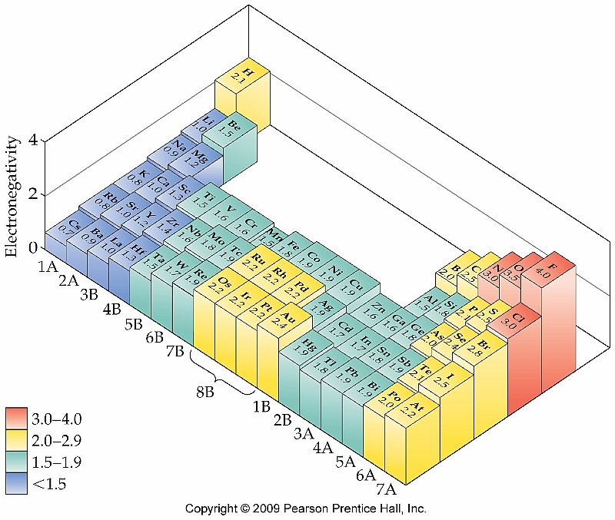
Trends in Electronegativity
The trend for electronegativity follows that of ionization energy:

Slide 12
Electronegativity and Bond Polarity
The difference in electronegativity between two elements determines the bond polarity
Although it is not a hard and fast rule, electronegativity differences greater than 2.5 usually indicate ionic compounds

Slide 13
Dipole Moments
As the difference in electronegativities increases, the bond becomes more and more polar and a dipole moment is created
Each bond in a compound could have a dipole moment
The net effect of each dipole moment adds up to an overall dipole for the entire molecule
Examples:
HF PFCl₂ CCl₄

