Slide 1
Electronic Structure of Atoms

Slide 2
The Wave Nature of Light
The visible light that we actually see with our eyes is simply one form of electromagnetic energy
Electromagnetic energy essentially behaves as if it were a wave propagating through space

Slide 3
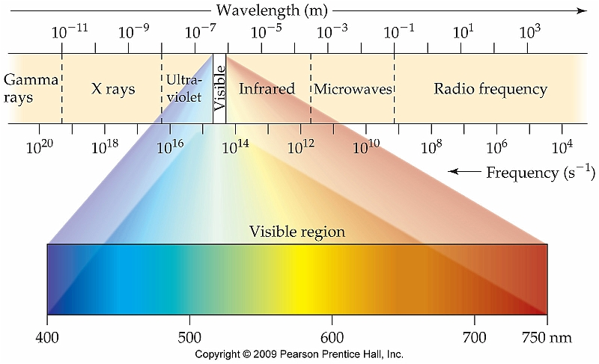
Electromagnetic Spectrum

Slide 4
Relationship Between Frequency and Wavelength
There is an inverse relationship between these two properties of electromagnetic radiation
High frequency = low or short wavelength and vice versa

Slide 5
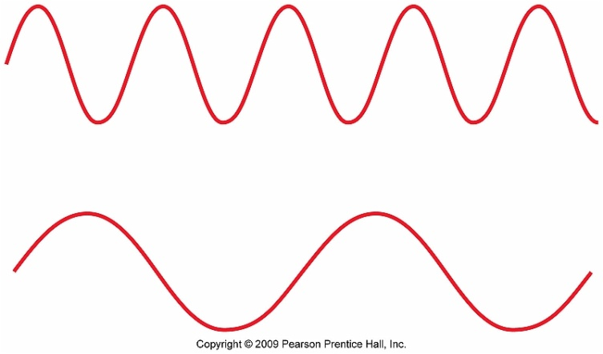
Examples
If the wavelength of the second wave is 324.7 nm, what would be the frequency of this wave?
See Sample Exercises 6.1and 6.2 (Pg. 214)

Slide 6
The Evolving Atomic Model
Democritus Model
Thomson “Plum Pudding” Model
Electrons present no nucleus
Rutherford model
Electrons and nucleus present but proton and neutron not discovered yet
**Each model revised based on experimentation and data analysis**

Slide 7
Introducing the Quantum
In 1900 Max Planck put forth his idea of "quantized energy"
Theorized that energy could only be absorbed or released in tiny discreet intervals known as quanta
Think of it as a staircase

Slide 8
Application of Einstein's Theory
(a.) The threshold frequency that can dislodge an electron from metallic sodium is 5.51 × 10¹⁴ Hz. What is the energy of this photon?
(b.) What is the energy, in Joules, of a photon with a wavelength of 430.0 nm?
See Sample Exercise 6.3 (Pg. 217)

Slide 9
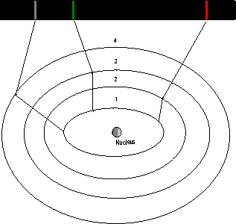
Bohr's Model of the Atom
Based on this idea of quantized energy Bohr put forth his new model of the atom which could be viewed as a "microscopic solar system"
Question: Why doesn't the electron spiral into the nucleus?

Slide 10
Bohr's Model of the Atom and Quantized States
Only orbits of exact radii are permitted
No in between orbits
An "allowed state" is one in which an electron has a specific energy
No spiraling into the nucleus
As an electron moves between "allowed energy states" a photon of energy is either absorbed or emitted

Slide 11
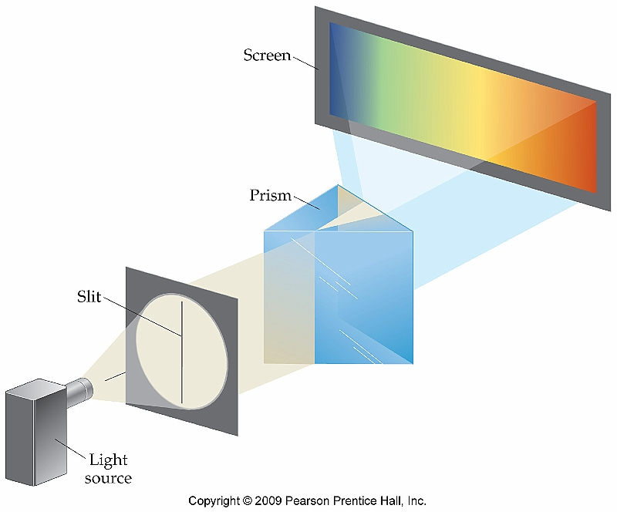
Line Spectra and the Bohr Model Section 6.3
It's well known that "white light" actually consists of a continuous spectrum of colored light
Scientists were therefore surprised when the emission spectra of particular elements were studied

Slide 12
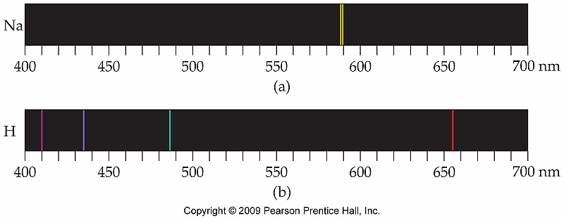
Emission Spectrum of Hydrogen
When a high voltage current is applied to a particular element, that element will emit wavelengths of light unique to that element

Slide 13
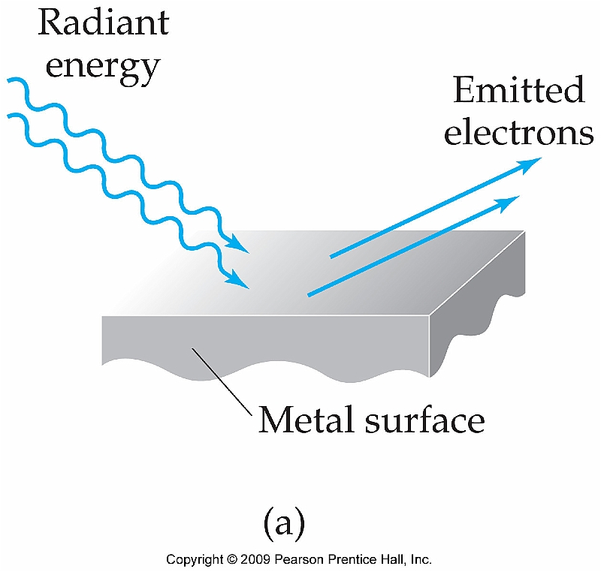
The Photoelectric Effect
It was well known by the turn of the 20th century that when light strikes the surface of particular metals it will cause electrons to be ejected from the surface
Ex: Electrons will be
ejected from the surface
of Cs metal with light with
a frequency of 4.60 × 10¹⁴ Hz

Slide 14
Photoelectric Effect (cont.)
Oddly, increasing the intensity of the light had no effect, only the frequency seemed to matter.
Einstein elaborated further on Planck's work and theorized that light could not only behave as a wave but also as discreet packets of energy:

Slide 15
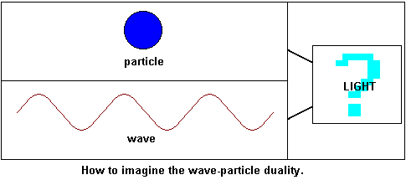
Dual Nature of Light
Einstein's theory implicated that light not only behaves as a wave, but can also behave as a tiny particle
Referred to as a photon
Is light best described as a wave or a particle?
The answer: YES

Slide 16
The Wave Behavior of Matter Section 6.4
The idea of electrons having wavelike properties was put forth by Louis de Broglie in his Ph.D. thesis (overachiever).
This idea can be extended to all matter regardless of mass:
Because the mass of an electron
is very small, the wavelength of
an electron is very small

Slide 17
Proof of Wavelike Properties of Matter (Just for Fun)

Slide 18
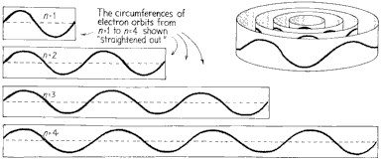
Electrons As Waves Around the Nucleus
Because there can be no constructive or destructive interference, the waves must perfectly fit around the nucleus
Otherwise they would cancel themselves out which is physically impossible

Slide 19
Werner Heisenberg and the Uncertainty Principle
We can either know the momentum of subatomic particles with great accuracy or their position
But NEVER both at the same time

Slide 20
Electrons Behaving as Waves
Electrons are extremely small pieces of matter and therefore can best be characterized as waves rather than particles
They therefore have more wavelike properties in particular it is possible for them to have nodes:
n = 0 (no node)
n = 1 (1 node)

Slide 21
Schrödinger and the Wave Function
Because of the Heisenberg Uncertainty Principle, we have no idea where an electron is at any given time
We can only speak about the probability of finding an electron in a given region of space:

Slide 22
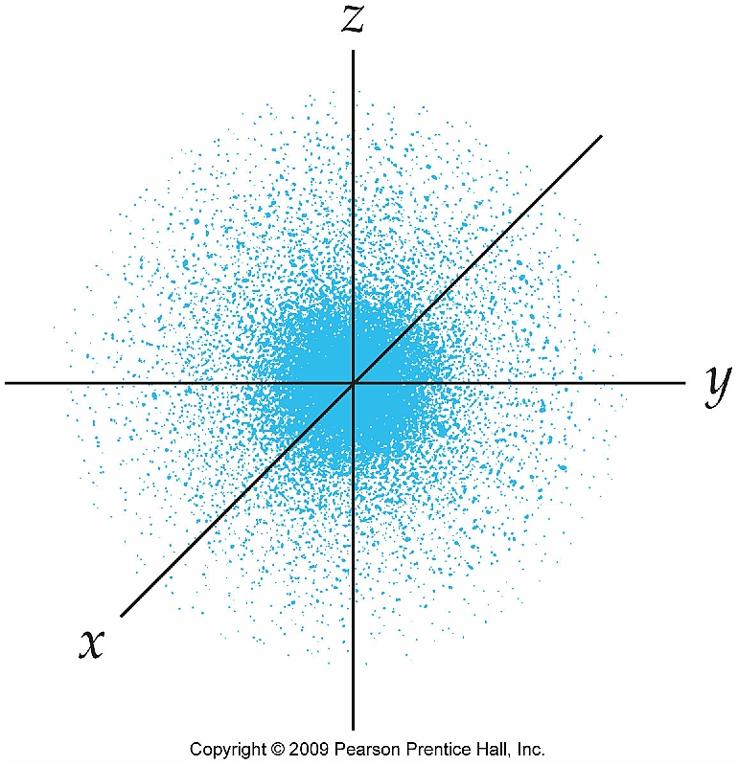
Probability Density
The shape of an atomic orbital simply defines the region of space that encompasses the probability or electron density for an electron

Slide 23
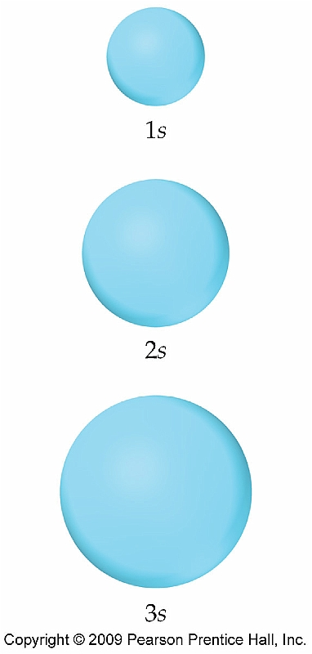
Representation of Orbitals (s Orbitals)
n = 1 (no node)

Slide 24
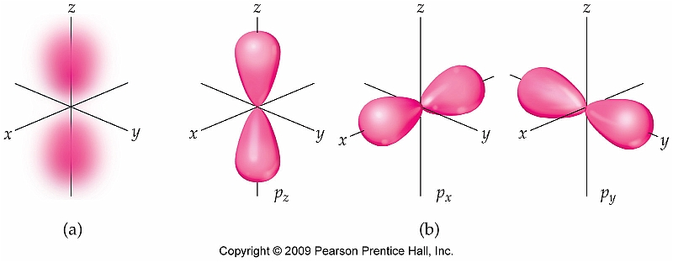
p Orbitals
n = 2 (1 node)

Slide 25
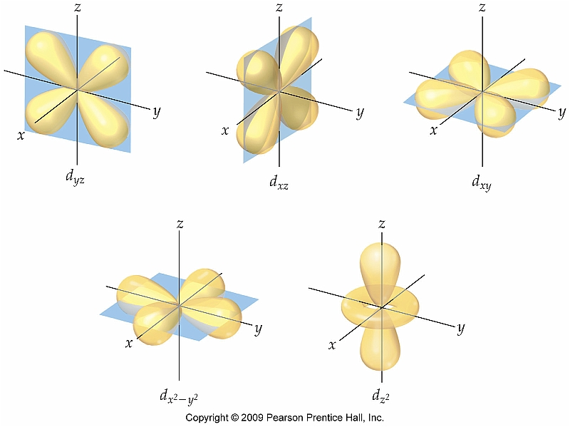
d and f Orbitals
n = 3
2 nodes

Slide 26
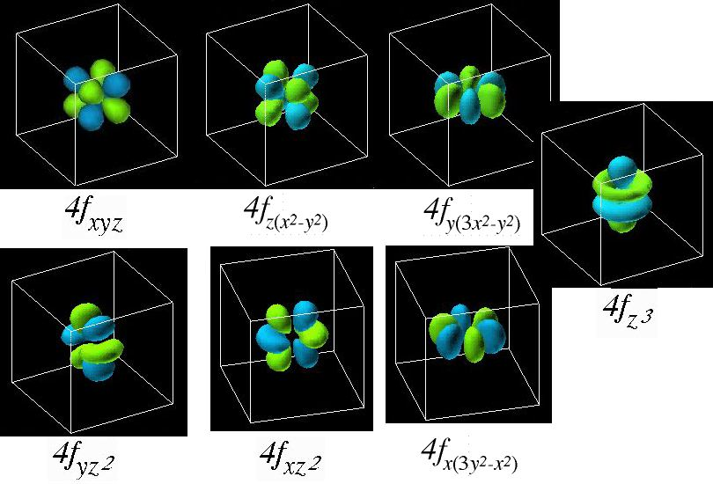
f Orbitals

Slide 27
Electron Arrangement in Many-Electron Atoms Section 6.7
Electrons are arranged energetically using the Aufbau principle
Lowest energy levels are filled first
Orbitals that have the same energy are referred to as degenerate

Slide 28
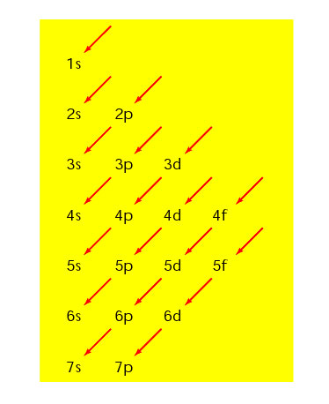
Assigning Electron Configurations
Using the Aufbau principle is made more simple by using the diagram at the right
Ex: What is the electron configuration of Be? F?

Slide 29
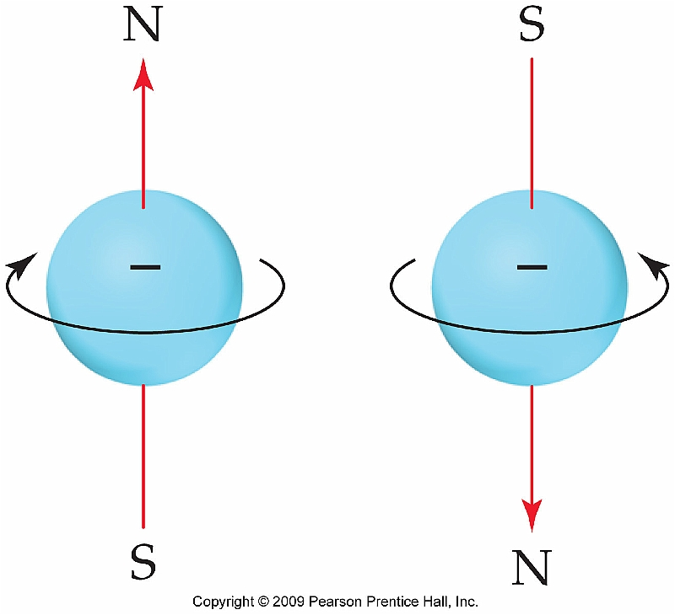
Electron Spin
Because each individual orbital is capable of holding two electrons, these electrons are distinguished by their spin

Slide 30
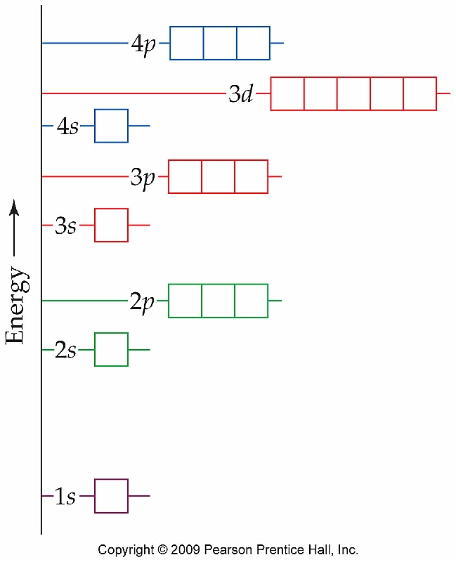
Orbital Diagrams
Pauli exclusion principle states that no two electrons can be the same energetically
Electrons in the same orbital must have opposite spin

Slide 31
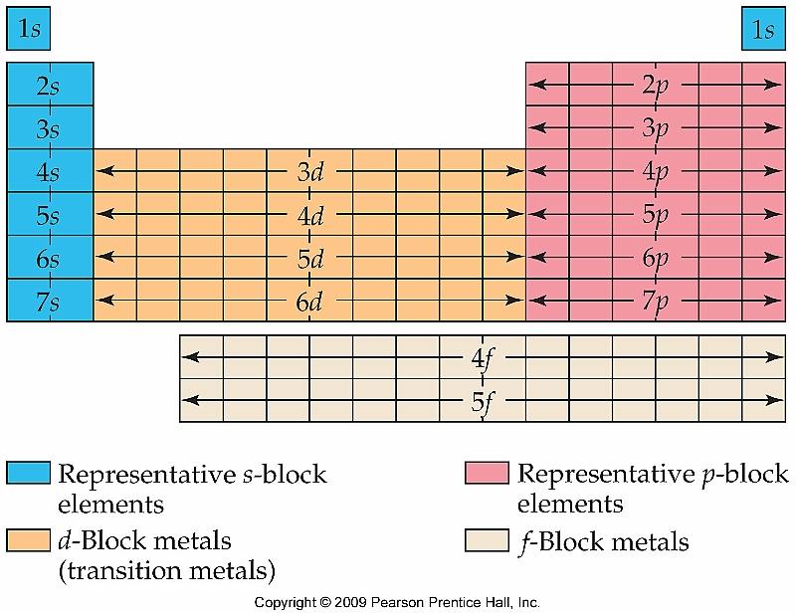
Electron Arrangement and the Periodic Table
The periodic table can actually be used as a direct shortcut in writing electron configurations
Contains 4 different “blocks”

Slide 32
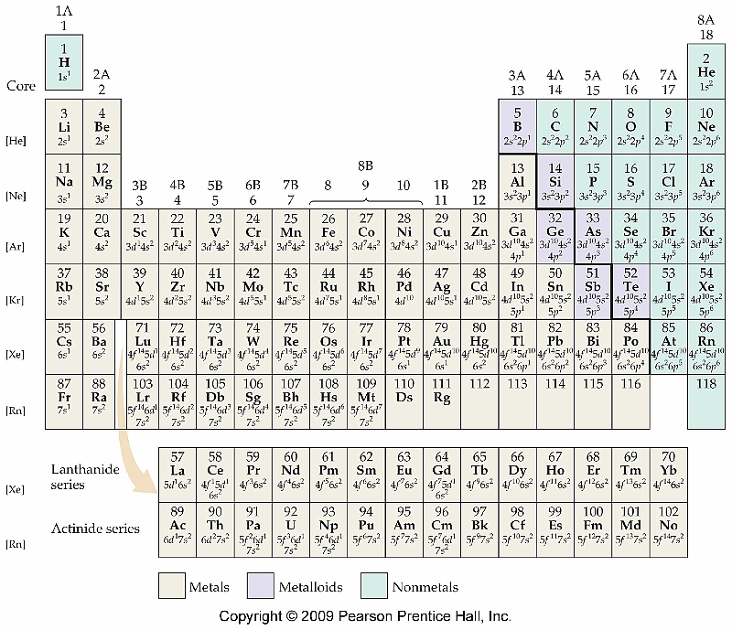
Predicting Valence Electrons Using the Periodic Table
The valence
electrons reside
in the last orbitals
to be filled

