Slide 1
Bonding: General Concepts
Chapter 8

Slide 2
Types of Chemical Bonds-- Section 8.1
A chemical bond is formed by sharing or donating electrons between multiple atoms
Three main types of chemical bonds:
Ionic (No sharing of electrons)
Covalent (Electrons are shared albeit to different extents)
Metallic (Occurs only in purely metallic samples, e.g. iron, copper, gold)

Slide 3
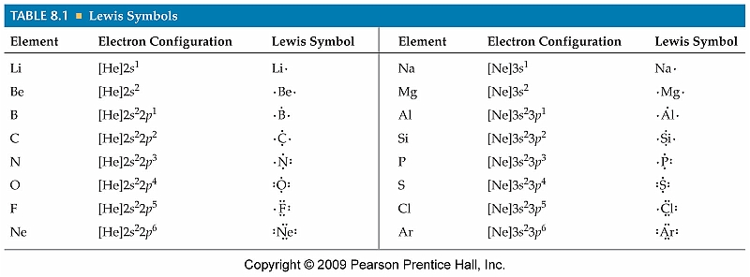
Lewis Symbols
Valence electrons are typically used to form chemical bonds between atoms
Valence electrons of elements are represented using Lewis dot symbols

Slide 4
Writing Lewis Dot Symbols
Determine the number of valence electrons for the element in question
Arrange them around the element symbol, only pairing them after 4 have been placed
Examples:
Ca O Br Al

Slide 5
Ionic Bonding
Ionic bonding typically occurs between metals and nonmetals
Involves the complete transfer of an electron (no sharing)

Slide 6
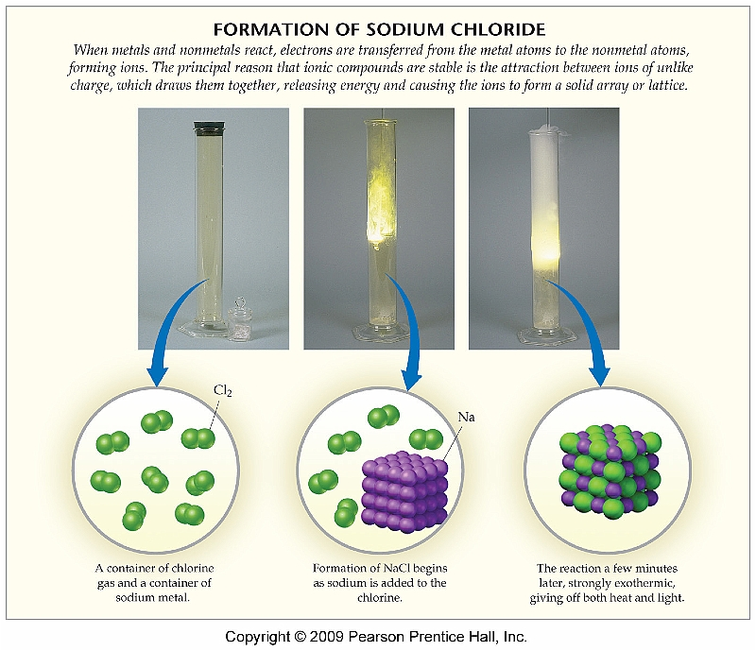
Formation of Sodium Chloride

Slide 7
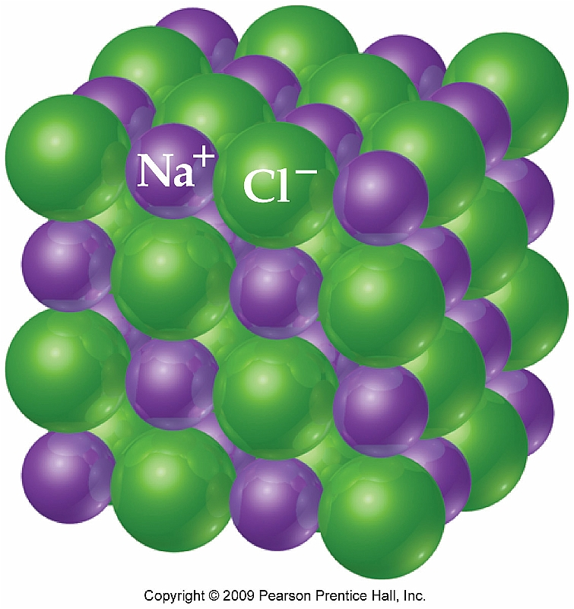
Typical Characteristics of Ionic Compounds
High melting points
Form crystalline (highly ordered) structures
Strong electrolytes
Brittle

Slide 8
Ionic Compounds and Lattice Energy
It is not really proper to speak of “molecules” of NaCl
Ionic molecules form an extended array of cations and anions that is referred to as a crystal lattice
Lattice energy is essentially the energy required to completely rip apart 1 mole of an ionic compound into gaseous ions
Coulombic forces for ionic crystal lattices play a major role:

Slide 9
Predicting Relative Lattice Energies
Predict which of the following would have the highest lattice energy out of each pair:
LiF or KF; LiCl or MgCl₂
Explain why the lattice energy of Na₂O is significantly higher than that of NaF.

Slide 10
Ion Formation and Electron Configuration
Why are ions formed in the first place?
Answer: Octet rule (obtaining noble gas electron configuration)
Ex: Reaction between Na and Cl
Na: 1s²2s²2p⁶3s¹ = [Ne]3s¹
Na⁺ = [Ne]
Cl: 1s²2s²2p⁶3s²3p⁵ = [Ne]3s²3p⁵
Cl⁻: 1s²2s²2p⁶3s²3p⁶ = [Ne]3s²3p⁶ = [Ar]

Slide 11
Covalent Bonding Section 8.7
Covalent bonding occurs when the electrons forming a chemical bond are shared rather than transferred from element to another
While this is the main difference between ionic and covalent it is important to understand that there is essentially a spectrum between ionic and covalent compounds

Slide 12
Lewis Structures Section 8.10
Covalent bonds in covalent compounds are often represented by Lewis structures:

Slide 13
Multiple Bonds
A single bond is formed by sharing a single pair of electrons
Double bonds use two pairs and triple bonds three
As the bond order increases; the bond length decreases

Slide 14
Drawing Lewis Structures
Determine the number of electrons shared between all elements for a particular molecule (S = N – A)
Make all the necessary bonds using the shared electrons
Place lone pairs of electrons around atoms that do not have an octet of electrons
Exceptions H only needs 2; Be only needs 4; B only needs 6

Slide 15
Drawing Lewis Structures
Draw Lewis structures for the following molecules:
CCl₄
CS₂
OSCl₂ (sulfur is central atom)
nitrate anion
See Interactive Example 8.6 (Pg. 328)

Slide 16
Bond Polarity and Electronegativity Section 8.3
The electrons that comprise a chemical bond between two elements are not necessarily shared equally
The degree to which electrons are shared is referred to as bond polarity
There are very few purely nonpolar covalent bonds
Ex: Any diatomic molecule (N₂, O₂, F₂)

Slide 17
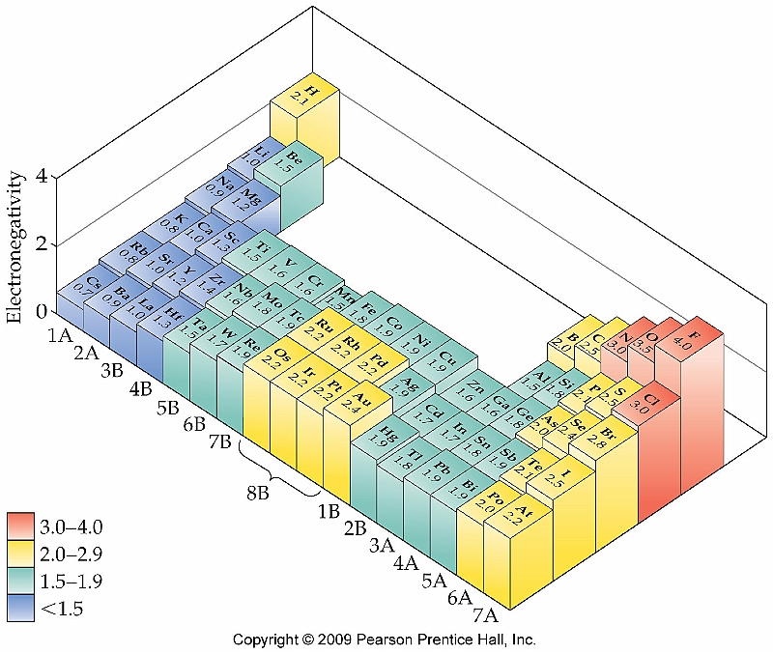
Trends in Electronegativity
The trend for electronegativity follows that of ionization energy:

Slide 18
Electronegativity and Bond Polarity
The difference in electronegativity between two elements determines the bond polarity
Although it is not a hard and fast rule, electronegativity differences greater than 2.5 usually indicate ionic compounds

Slide 19
Dipole Moments
As the difference in electronegativities increases, the bond becomes more and more polar and a dipole moment is created
Each bond in a compound could have a dipole moment
The net effect of each dipole moment adds up to an overall dipole for the entire molecule
Examples:
HF PFCl₂ CCl₄

Slide 20
Formal Charge
Formal charges for each atom must add up to the total charge on the molecule
Formal charge does not represent the actual charge on an atom, it is simply a method that is used to keep track of the electrons in a molecule
Example: Sulfate anion:

Slide 21
Lewis Structures and Formal Charge
When more than one Lewis structure is possible, the formal charges for each atom must be taken into account to provide the best Lewis structure:
The fewest number of formal charges represents the best Lewis structure
Negative formal charges should be placed on the atoms with the greatest electronegativities
Ex: thiocyanate ion (NCS⁻):

Slide 22
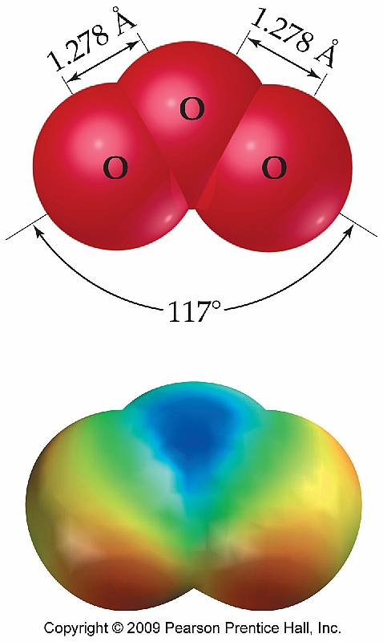
Resonance Structures Section 8.6
A molecule can have different resonance structures when two or more equal Lewis structures are possible
The bonds in resonance structures typically have lengths that are in between that of a single and double bond
Ex: nitrate ion (NO₃⁻) and ozone (O₃)

Slide 23
Sample Question
Write all possible resonance structures for the following species. Assign a formal charge to each atom. In each case which resonance structure is most important?
NO₂⁻ (N is central atom)
ClCN (C is central atom)

Slide 24
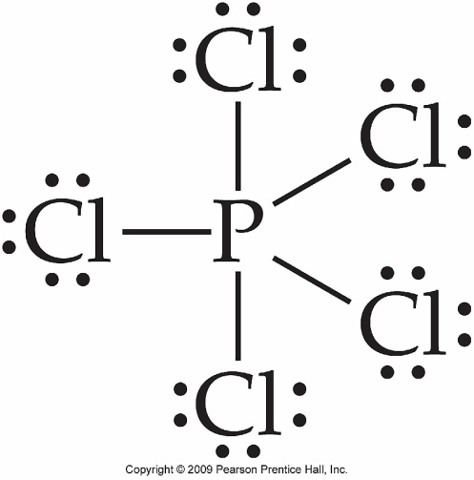
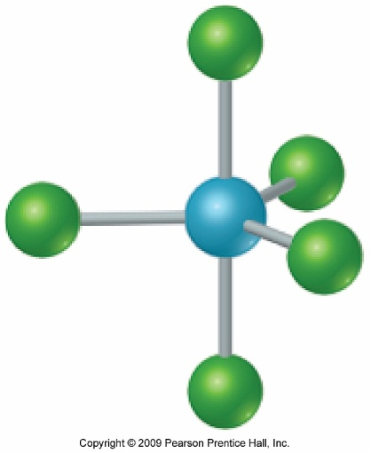
Exceptions to the Octet Rule Section 8.11
H, Be, and B have been previously mentioned as exceptions; however there are many examples of atoms with expanded octets
Elements capable of having expanded octets: S, I, Xe, P, Sb, Cl, As, Se, Br, Te
Ex: PCl₅

Slide 25
How is Octet Expansion Possible?
The elements shown on the previous slide all have empty d-orbitals that are capable of accepting electrons for octet expansion
Ex: P

Slide 26
Drawing Lewis Structures w/ Expanded Octets
Draw Lewis structures for each of the species shown below indicating formal charge in all cases.
PF₅
XeF₂
SF₆
See Interactive Example 8.7 (Pg. 331)

Slide 27
Expanded Octet Structures that Contain Oxygen
For compounds that have a central atom with an expanded octet and bonded to oxygen, you must see if increasing the bond order will result in a better Lewis structure
Examples: sulfate and sulfite ions

Slide 28
Odd Electron Species
There are a few molecules that have an odd number of valence electrons
As a result, it is impossible to place an octet of electrons around each atom
Ex: ClO₂, NO, NO₂

Slide 29
Strengths of Covalent Bonds Section 8.8
The bond enthalpy, ΔH, is the enthalpy change associated with the breaking of a chemical bond
Example:
CH₄(g) → C(g) + 4H(g) ΔH = 1660 kJ

Slide 30
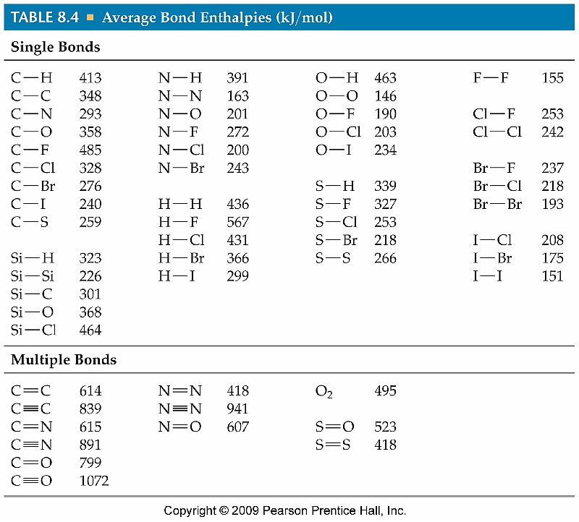
Average Bond Enthalpies for Common Covalent Bonds

Slide 31
Bond Enthalpies and Enthalpies of Reaction
The ΔH_{rxn} can be estimated using Hess’s Law if the bond enthalpies for each chemical bond that’s broken or formed is known:
ΔH_{rxn} = Σ(ΔH_{bonds broken}) - Σ(ΔH_{bonds formed})

Slide 32
Using Average Bond Enthalpies
Using Table 8.5, estimate ΔH for the following reaction:
CH₄(g) + 2O₂(g) → CO₂(g) + 2H₂O(g)
See Sample Exercise 8.5 (Pg. 324)

Slide 33
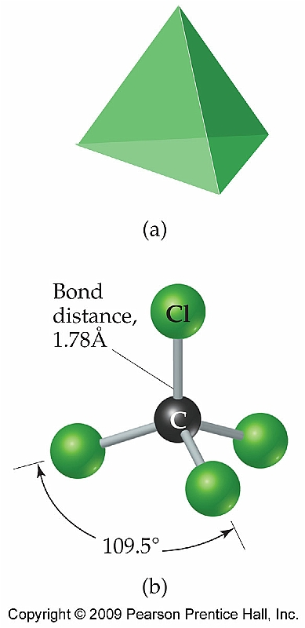
Molecular Structure: The VSEPR Model--Section 8.13
Lewis structures only provide a 2-D representation of a molecule
However, by including the bond angles of molecules, a more accurate 3-D representation can be achieved

Slide 34
VSEPR Theory
Valence Shell Electron-Pair Repulsion (VSEPR) theory states that the overall shape of a molecule is governed by the interactions of its electron clouds
The electron clouds for a given molecule repel each other and must separated as best as possible to minimize this repulsive interaction

Slide 35
The VSEPR Model
The electron domains included in the VSEPR model can be divided into two different categories:
Bonding pairs
Nonbonding (lone) pairs

Slide 36
Electronic vs. Molecular Geometries
The electronic geometry describes the shape of the electron clouds surrounding the central atom
Regardless of whether they are lone pairs or bonding pairs
The molecular geometry takes into consideration the effect of lone pairs but ignores their existence

Slide 37
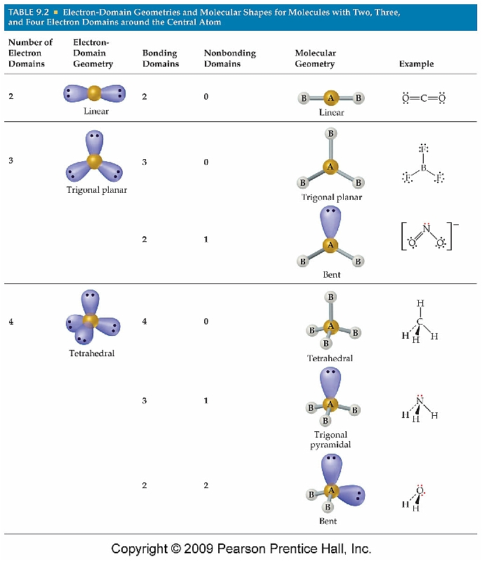
Electronic and Molecular Geometry

Slide 38
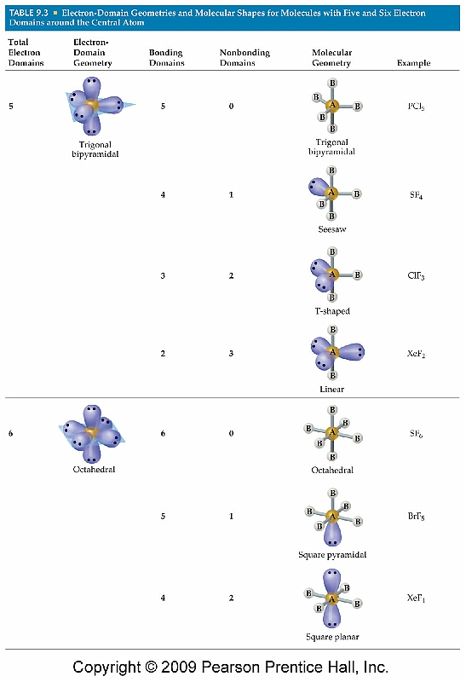
Electronic and Molecular Geometry (cont.)

Slide 39
Determining the Shape of a Molecule
Draw Lewis structure
Determine number of lone pairs and bonding pairs (electronic geometry)
Remove lone pairs and determine molecular geometry

Slide 40
Examples
Draw Lewis structures and determine both electronic and molecular geometries for the following molecules:
H₂O
ClNO (N as central atom)
CO₃²⁻
See Interactive Example 8.11 (Pg. 340)

Slide 41
Deviations from Ideal Bond Angles
The bond angles listed for the electronic geometries are ideal values
Several factors affect these ideal values
Existence of lone pairs
Large atoms
Bond orders >1
Lone pairs of electrons and bond orders >1 have the most significant impact

Slide 42
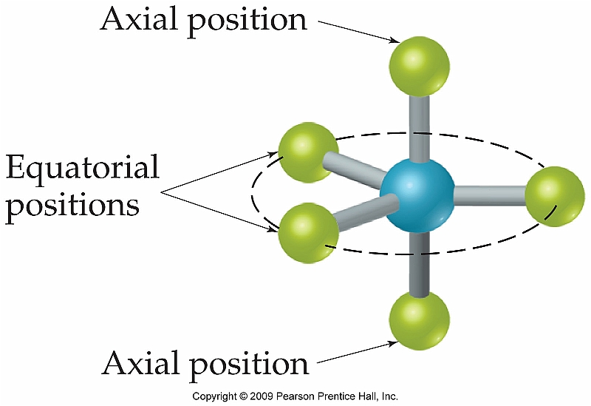
Geometries for Molecules w/ Expanded Octets
Trigonal pyramidal and octahedral geometries have two geometrically distinct points:
Equatorial
Axial

Slide 43
Examples
Draw Lewis structures and predict electronic and molecular geometries for each molecule shown:
BrF₅
XeF₄
ClF₃
See Interactive Example 8.12 (Pg. 344)

Slide 44
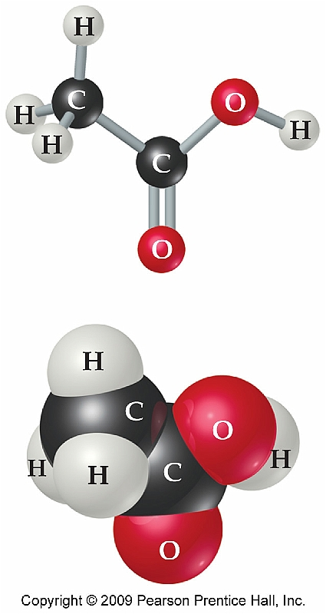
Shapes of Larger Molecules
Molecular geometry can only be described with respect to a central atom
Molecules containing more than one central atom therefore have a different geometry about each particular atom

Slide 45
Bond Polarity (Revisited)
Predict whether the following molecules are polar or nonpolar:
CH₄
HCN
H₂O
XeF₄

Slide 46
Chapter 9
Covalent Bonding: Orbitals

Slide 47
Hybridization and the Localized Electron Model--Section 9.1
We know that Lewis structures provide a qualitative approach at determining molecular shape and that Schrodinger’s quantum #’s give us the shapes of atomic orbitals
These two concepts can be joined to form valence-bond theory

Slide 48
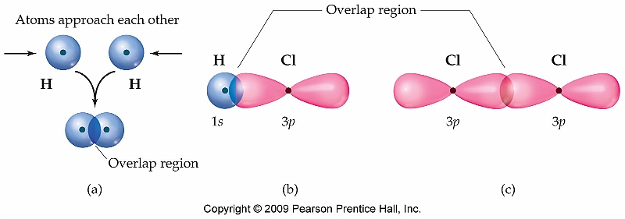
Orbital Overlap (VSEPR Theory)
Chemical bonds are simply represented with lines in a Lewis structure; however covalent bonds are formed from the overlap of atomic orbitals between two atoms

Slide 49
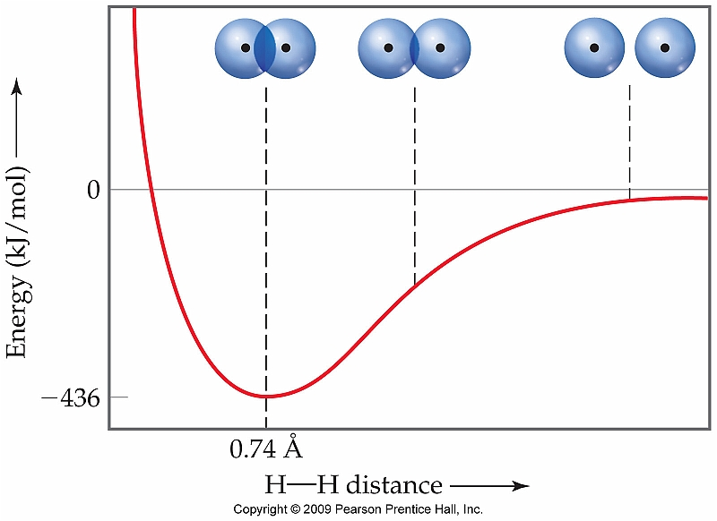
Bond Length

Slide 50
Hybrid Orbitals (Valence-Bond Theory)
Under valence-bond theory, the atomic orbitals used to create new chemical bonds mix together (hybridize) to create new hybrid orbitals
Example: BeF₂

Slide 51
sp Hybridization (Two bonds)
The two new orbitals that are formed by mixing of the 2s and 2p orbitals are the hybrid orbitals
This allows Be to interact with two F atoms instead of one

Slide 52
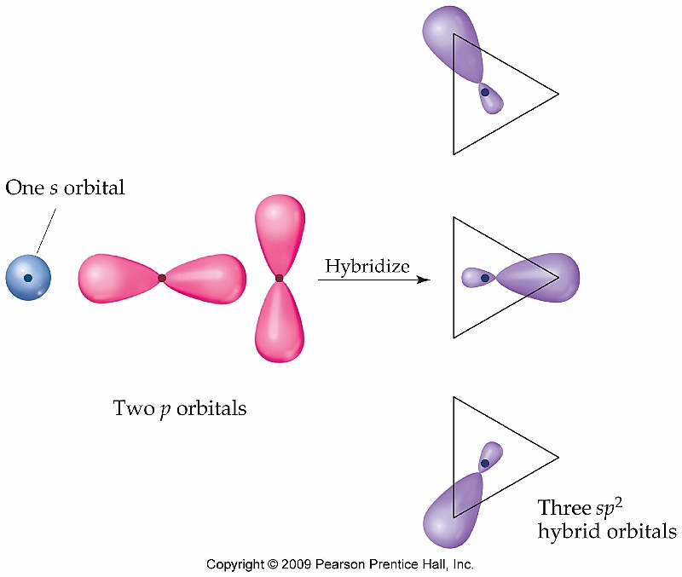
Hybridization in BCl₃ (Three bonds)
Hybridization of the 2s and two 2p orbitals leads to sp² hybridization:

Slide 53
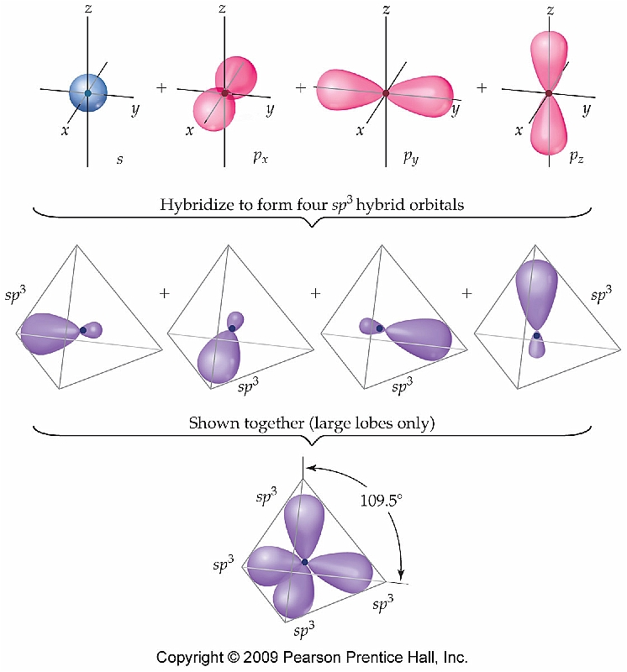
Hybridization in CCl₄ (Four bonds)
Hybridization of the 2s and three 2p orbitals leads to sp³ hybridization:

Slide 54
Hybridization Involving d Orbitals
Elements capable of having an expanded octet use the empty d orbitals to do so; therefore hybrid orbitals can be created using d orbitals as well:
5 electron clouds → sp³d
6 electron clouds → sp³d²

Slide 55
Summary
# of electron clouds | Electronic Geometry | Hybrid Orbital Set | Example
2 | Linear | sp | BeH₂
3 | Trig. Planar | sp² | BCl₃
4 | Tetrahedral | sp³ | NH₃
5 | Trig. Bipyramidal | sp³d | PCl₅
6 | Octahedral | sp³d² | SF₆

Slide 56
Examples
Write the Lewis structure, predict electronic and molecular geometries, and identify the hybrid orbital set for each molecule shown below.
SO₃
NH₄⁺
SF₄
PF₆⁻
See Interactive Example 9.5 (Pg. 364)

Slide 57
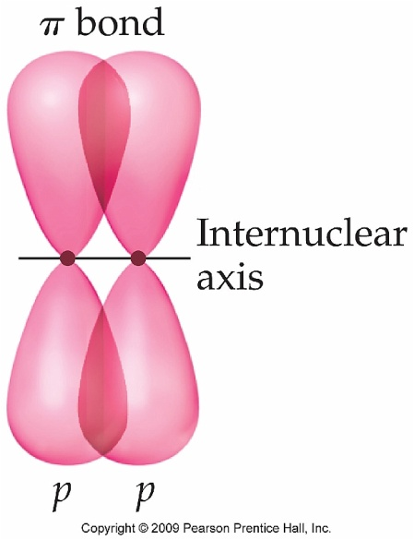
Multiple Bonds
All single bonds run along a line that passes through the nucleus of each atom and are known as sigma (σ) bonds
A different bond forms when considering multiple bonds
Involves side to side overlap of two p orbitals to form pi (π) bonds

Slide 58
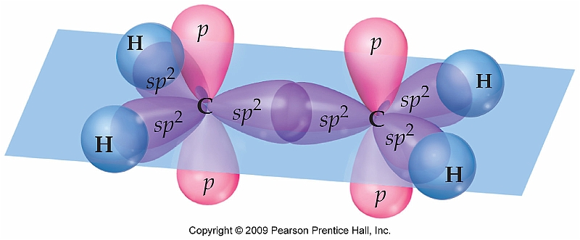
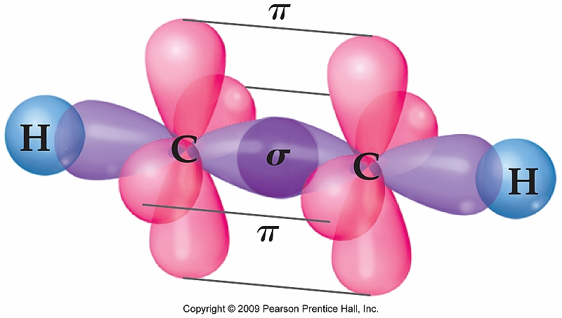
Hybridization in Ethylene and Acetylene

