Slide 1
Liquids and Solids
Chapter 10

Slide 2
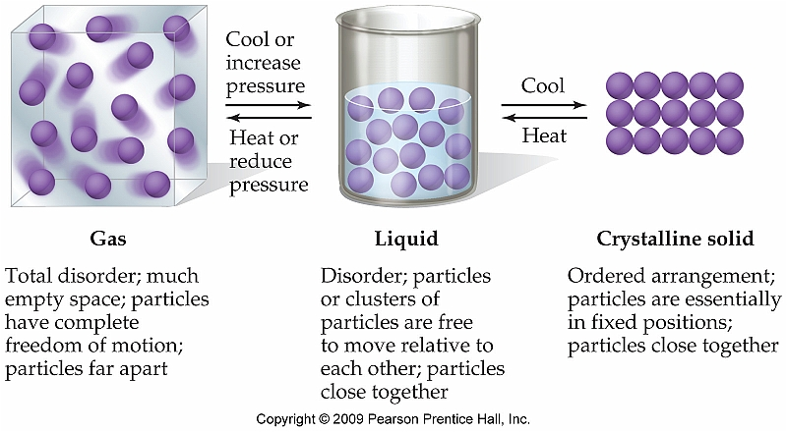
Solids, Liquids, and Gases: A Comparison
The physical state that a substance is most directly influenced by the amount of kinetic energy present in the substance

Slide 3
Intermolecular Forces Section 10.1
The physical properties of liquids are largely dominated by the effects of intermolecular forces
Vapor pressure
Boiling point
Melting point
Surface Tension
Capillary Action

Slide 4
Ion-Ion Interactions
Strongest interaction
Most often are found in ionic solids (very few ionic liquids)
Strongest because it involves a full negative and positive charge (not partial)

Slide 5
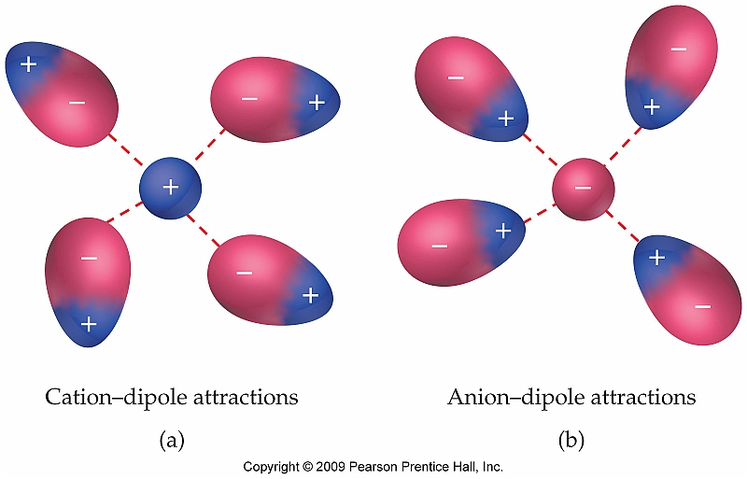
Ion-Dipole Forces
Ion-dipole forces exist between an ion with a full charge and the oppositely charged end of a dipole on a different molecule

Slide 6
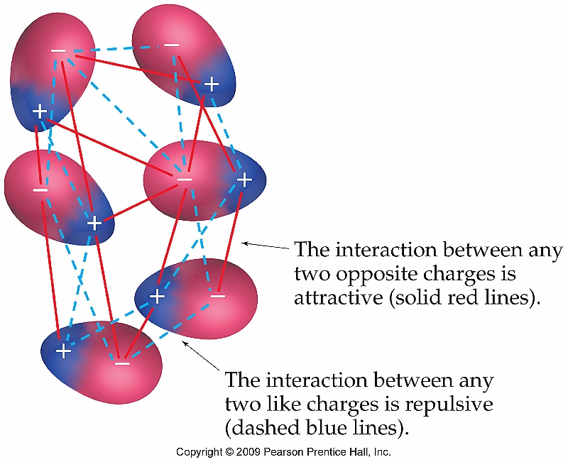
Dipole-dipole Forces
Similar to ion-dipole, but involves the alignment of dipoles of two different polar compounds
The strength of dipole-dipole interactions increases as the strength of the bond dipoles increase

Slide 7
H-Bonding (Special Case of Dipole-Dipole Interaction)
For a H-bond to form the following two criteria must be met:
A covalent bond containing hydrogen must exist (N-H, O-H, or F-H bond)
H-bond donor
A lone pair of electrons must exist
H-bond acceptor

Slide 8
London Dispersion Forces
London dispersion forces exist for every single molecule (both polar and nonpolar)
They are the only intermolecular force present for nonpolar molecules or atoms, however
Strength of dispersion forces depends on the polarizability of the atom or molecule

Slide 9
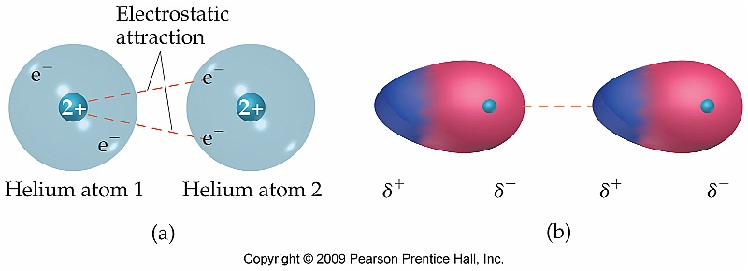
Polarizability
The polarizability of a molecule describes the extent to which the electron distribution can be altered creating an instantaneous dipole
As a result, large atoms or molecules tend to have stronger dispersion forces than smaller

Slide 10
Predicting Boiling Points Using IMFs
Identify the intermolecular forces and predict which substance of each pair has the stronger force of attraction.
CF₄ and CCl₄
CH₃OH and CHCl₃
ClF and BrF

Slide 11
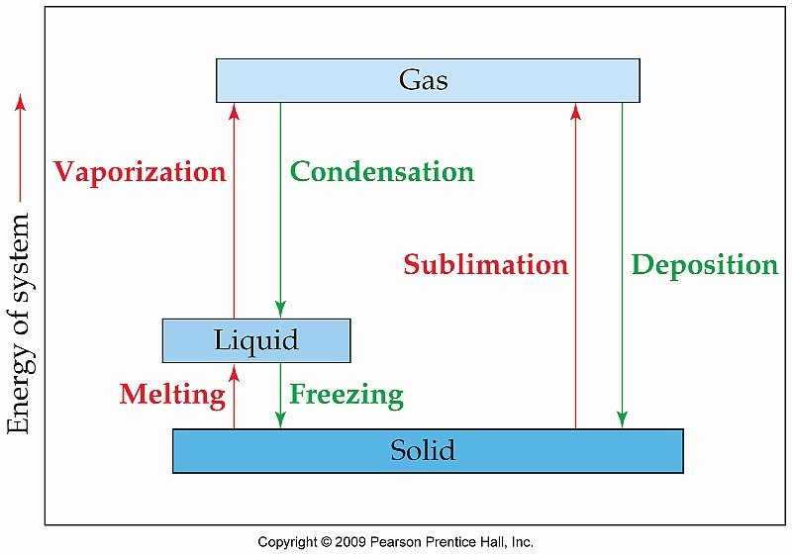
Vapor Pressure and Changes of State--Section 10.8
As the individual particles of a solid, liquid, or gas gain or lose kinetic energy, they may go through a series of phase changes

Slide 12
Heat of Fusion and Heat of Vaporization
Heat of fusion, ΔH_{fus}, is the amount of energy required to convert a solid into a liquid (melt)
Ex: H₂O (s) H₂O (l) ΔH_{fus} = 6.01 kJ/mol
Heat of vaporization, ΔH_{vap}, refers to the energy required to convert a liquid into a gas or vapor
Ex: H₂O (l) H₂O (g) ΔH_{vap} = 40.7 kJ/mol

Slide 13
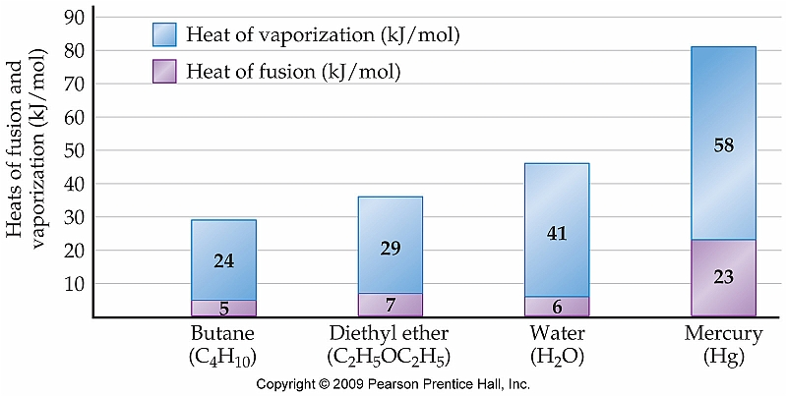
Comparison
What can be said about the intermolecular forces
for each of the compounds shown here?

Slide 14
Heat of Sublimation
On rare occasions compounds will change directly from a solid into a gas
Ex: CO₂ (dry ice) and I₂
Heat of sublimation, ΔH_{sub} is therefore the sum of ΔH_{fus} and ΔH_{vap}
Ex: CO₂ (s) CO₂ (g) ΔH_{sub} = 25.2 kJ/mol

Slide 15
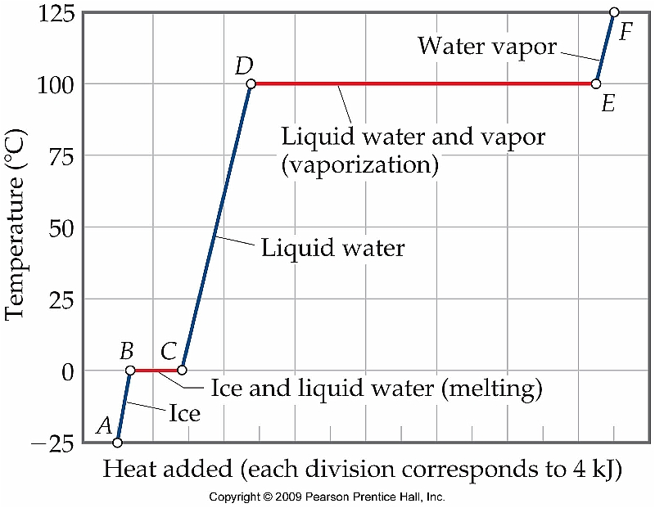
Heating Curves
Heating curve for H₂O

Slide 16
Enthalpy Changes Associated with Phase Changes
Calculate the enthalpy change upon converting 2.30 mol of ice at -25 °C to water vapor steam at 125 °C under a constant pressure of 1 atm. The specific heats of ice, water, and steam are 2.03 J/g-K, 4.18 J/g-K, and 1.84 J/g-K, respectively. For H₂O, ΔH_{fus} = 6.01 kJ/mol and ΔH_{vap} = 40.67 kJ/mol.

Slide 17
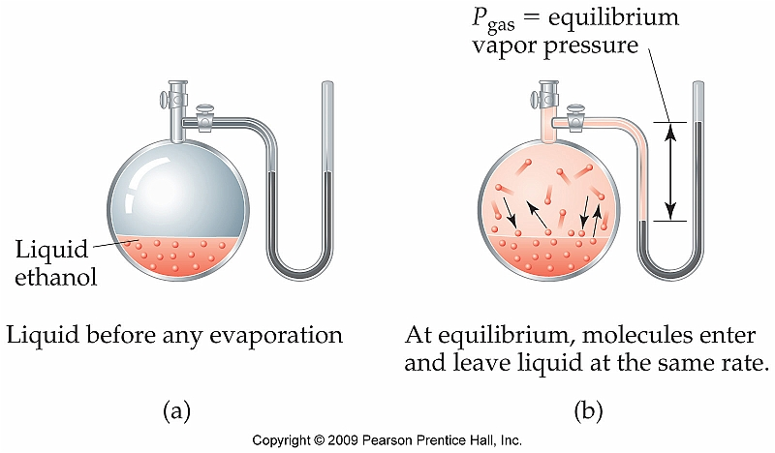
Vapor Pressure
The vapor pressure of a liquid is the result of a dynamic equilibrium between the liquid and gas phases of that liquid
Substances with very high vapor pressures are said to be very volatile
Ex:

Slide 18
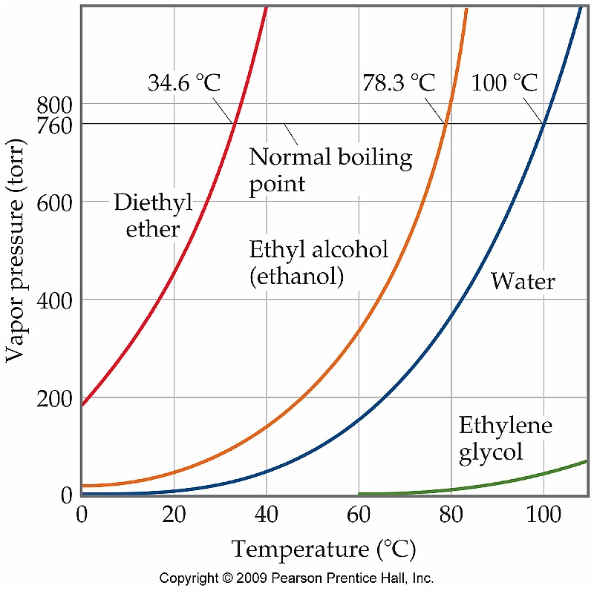
Vapor Pressure and Boiling Point
A liquid will begin to boil when it’s vapor pressure equals the external pressure acting on the surface of the liquid
Boiling point can be altered by a change in pressure (this is why some cooking directions include high altitude directions)
The boiling point of a liquid at 1 atm (760 torr) is referred to as the normal boiling point

Slide 19
An Introduction to Structures and Types of Solids--Section 11.7
Solids can be categorized based on two criteria:
Structure
Crystalline solid
Amorphous solid
Type of bonding
Covalent-network
Ionic
Metallic
Molecular

Slide 20
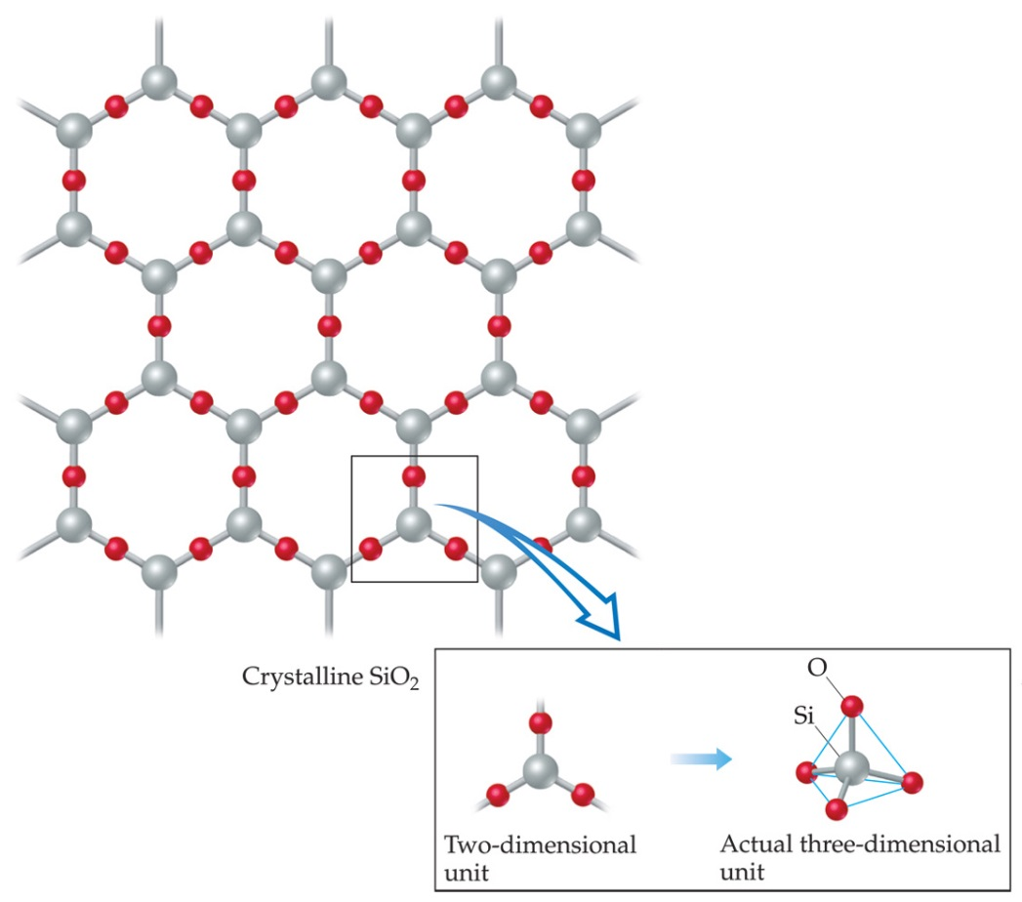
Amorphous vs. Crystalline
Crystalline
-- Very organized, repeating structure
Amorphous
-- Covalently bound, but not as organized

Slide 21
Bonding in Solids Section 11.8
Solids can be further classified by the types of intermolecular forces at work in the sample
Molecular
Covalent-network
Ionic
Metallic

Slide 22
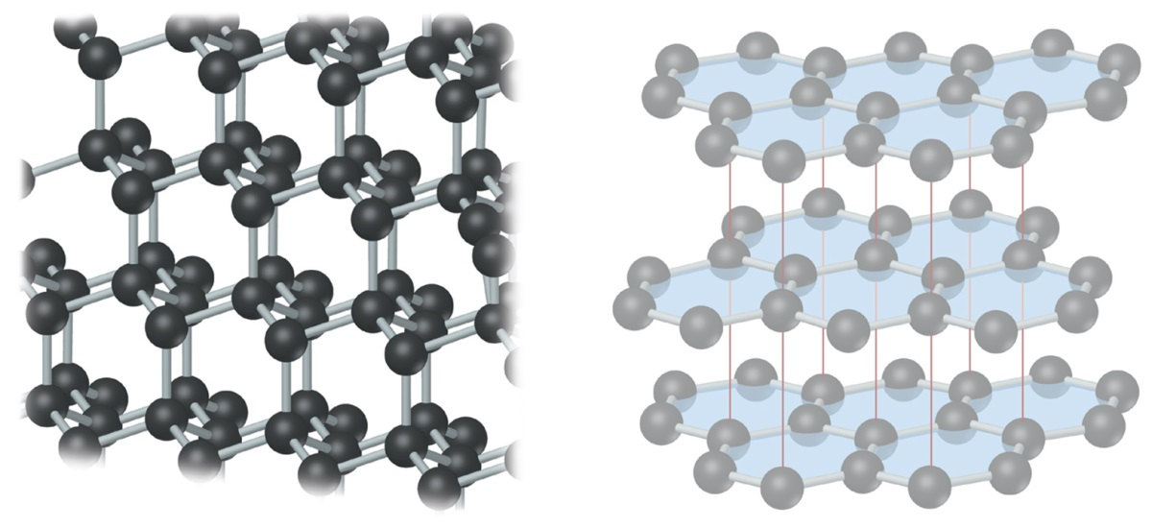
Types of Solids
Molecular Solids
Forces at work: London dispersion, dipole-dipole, H-bonding
Ex: Ar, CH₄, CO₂(s), etc
Covalent-Network Solids
Forces at work: Covalent bonds
Essentially one gigantic molecule
Ex: Diamond, SiO₂ (quartz)
Covalent-Network solids

Slide 23
Types of Solids (cont.)
Ionic Solids
Made up of ionic compounds
Forces at work: Ion-ion
Metallic Solids
Made up of metallic elements
Forces at work: Metallic bonds

Slide 24
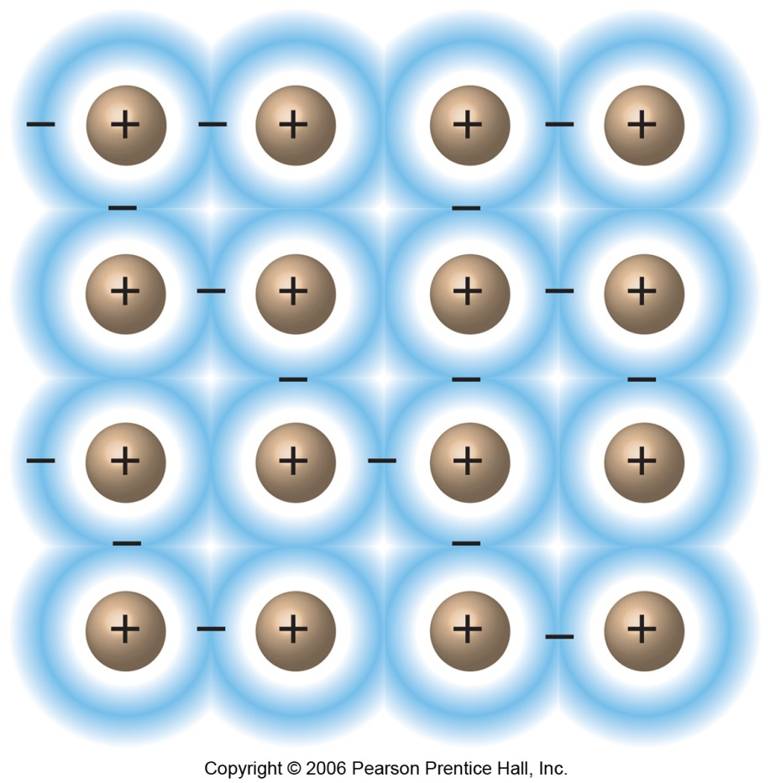
Structure and Bonding in Metals Section 10.4
Metallic bonds are more than simply dispersion forces between atoms of metals
Much stronger than that
The bonding is best described as the valence electrons spread out over the entire sample of metal
Sea of electrons

